Slide 1
Increasing Water Security
the Key to Implementing the
Sustainable Development Goals
Launch of GWP Background Paper No. 22
Stockholm, 12 May 2016

Slide 2
This paper offers
Critical review of the IWRM approach to increasing water security: its successes and disappointments
Background information for guiding SDG 6.5 (and IWRM) implementation and the interventions that may help to improve the all-round working of water economies related to the various stages of economic and social evolution

Slide 3
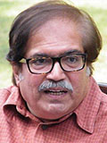
Structure of the paper
Sustainable Development Goals and IWRM
Evolution of IWRM – from process to output: Water Security
Putting IWRM into practice – the IWRM package
Transforming water economies
Lessons learned
Produced by GWP Technical Committee
Lead Author: Tushaar Shah

Slide 4
Research questions addressed in the paper
What lessons come from those who have experience in IWRM implementation?
What are the implications for achieving SDG-6?
What are the factors that (really) drive increases in national water security?

Slide 5
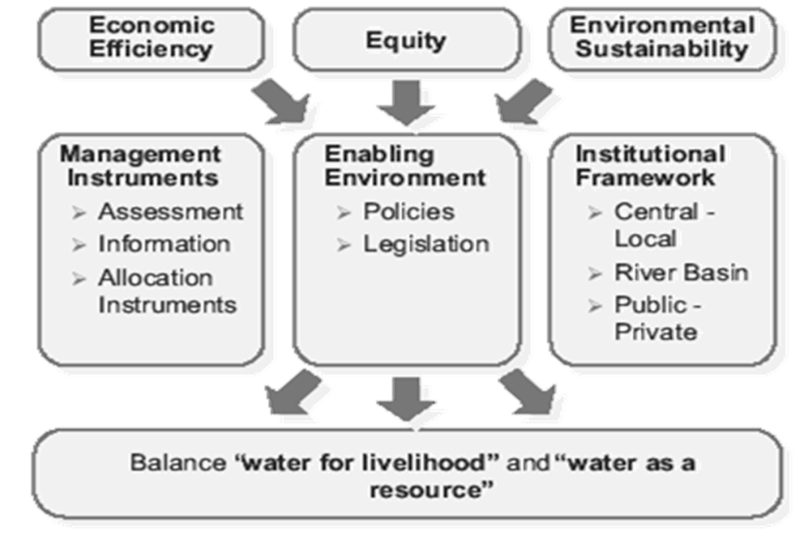
Putting IWRM into practice
Many successes
But also criticism: “IWRM is fuzzy, ambiguous and bereft of practical substance”
Pushing the “IWRM Package” as generic solution
too much North-oriented?
cosmetic adoption by the South?
Are there alternatives for this IWRM package?

Slide 6
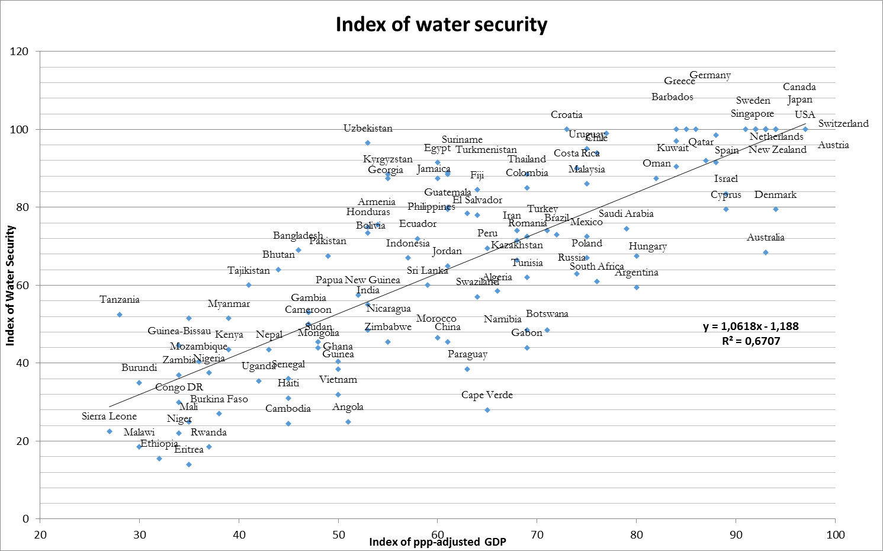
Drivers: Positive relationship between water security and GDP

Slide 7
Transformation of informal water economies with overall economic growth
Stage 1: Completely informal | Stage 2: Largely informal | Stage 3: Formalizing | Stage IV: Highly formal water industry

Slide 8
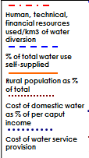
Transformation of Informal Water Economies with Overall Economic Growth
 | Stage I: Completely Informal | Stage II: Largely Informal | Stage III: Formalizing |  | Stage IV: Highly Formal Water Industry
% of users in the formal sector | <5% | 5-35% | 35-75% |  | 75-95%
Examples | Sub-Saharan Africa | India, Pakistan, Bangladesh | Mexico, Thailand, Turkey, Eastern China |  | USA, Canada, Western Europe, Australia
Dominant mode of water service provision | Self-supply and informal mutual-help community institutions | Partial Public Provisioning but self-supply dominates | Private-public provisioning; attempts to improve service and manage the resource |  | Rise of modern water industry; High Intermediation; self-supply disappears
Human, technical, financial resources used/km3 of water diversion % of total water use self-supplied Rural population as % of total Cost of domestic water as % of per caput income Cost of water service provision
Concerns of the Governments | Infrastructure creation in Welfare Mode | Infrastructure and Water services, especially in Urban areas |  | Infrastructure and service in towns and villages; Cost recovery; Resource protection |  | Integrated mgt. of water infrastructure, service and resource; Resource protection
Institutional Arrangements | Self-help; mutual help and feudal institutions dominate | Informal Markets; Mutual help and community management institutions |  | Organized service providers; self-supply declines; informal institutions decline in significance |  | Self-supply disappears; all users get served by modern water industry.

Slide 9
Priorities for achieving SDGs
 | Stage 1 | Stage 2 | Stage 3 | Stage 4
Capacity building | ….. | ….. | ….. | …..
Institutional reforms | ….. | ….. | ….. | …..
Policy and legal regime | ….. | ….. | ….. | …..
Investment priority | ….. | ….. | ….. | …..
Managing ecosystem impacts | ….. | ….. | ….. | …..
Water as a social and economic good | …. | …. | …. | ….

Slide 10
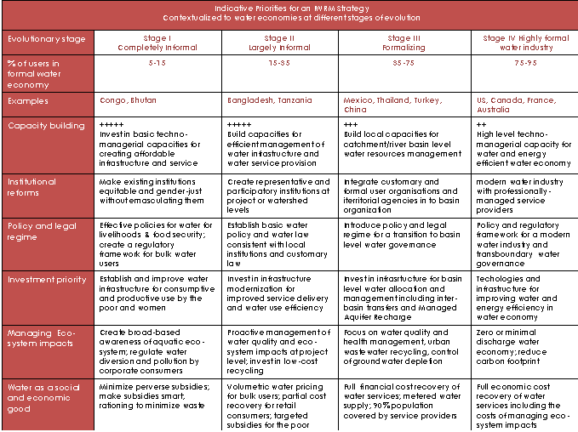

Slide 11
Key findings
The implementation of integrated approach in water resources management must be gradual and nuanced. Forcing the pace on developing countries has so far proved counterproductive.
Countries at different stages of socio-economic evolution have different needs and capabilities and it is essential to reflect this in the approach taken.
This applies for IWRM but also for the SDGs

Slide 12
Target audience:
Who should read the paper
Donor agencies who are eager to parashoot with IWRM projects
Policy makers that are inspired by donors to articulate IWRM plans
GWP staff at all levels (country, regional, global)
Water Resources Planners involved in IWRM activities

Slide 13
Read the full paper here
For more knowledge products of GWP Technical Committee here:
http://www.gwp.org/en/ToolBox/PUBLICATIONS/

